Slide 1


+
July 24, 2024
AD-X Core Form Completion Tracker
Owner
Omar Alabed
Controls
& Filters
Job Business Segment contains Guard

Slide 2

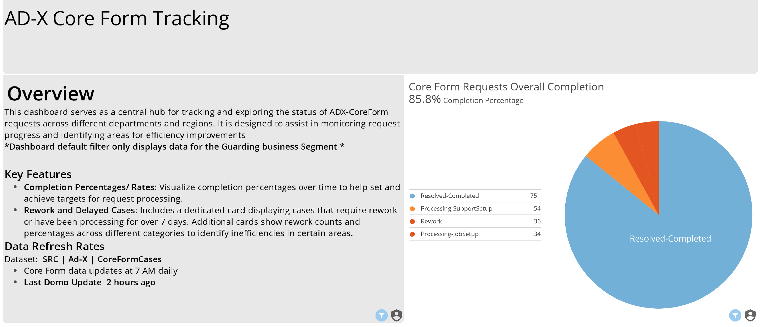

Slide 3
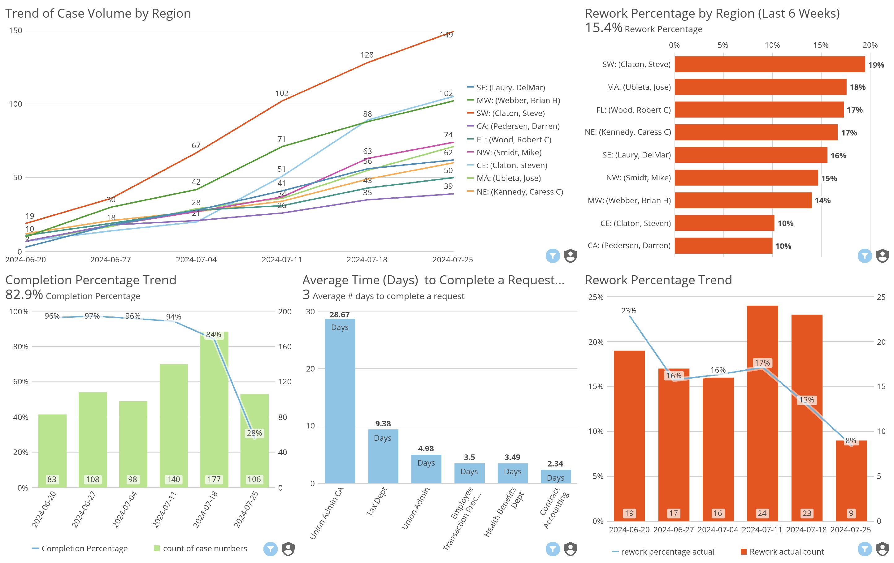

Slide 4
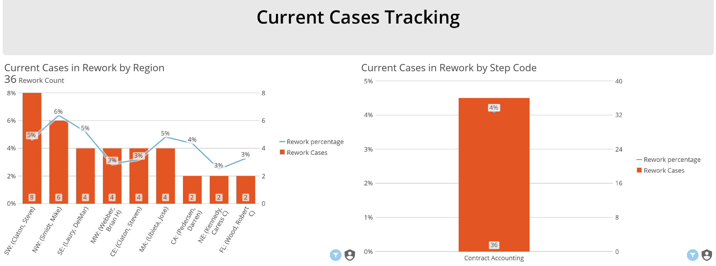

Slide 5
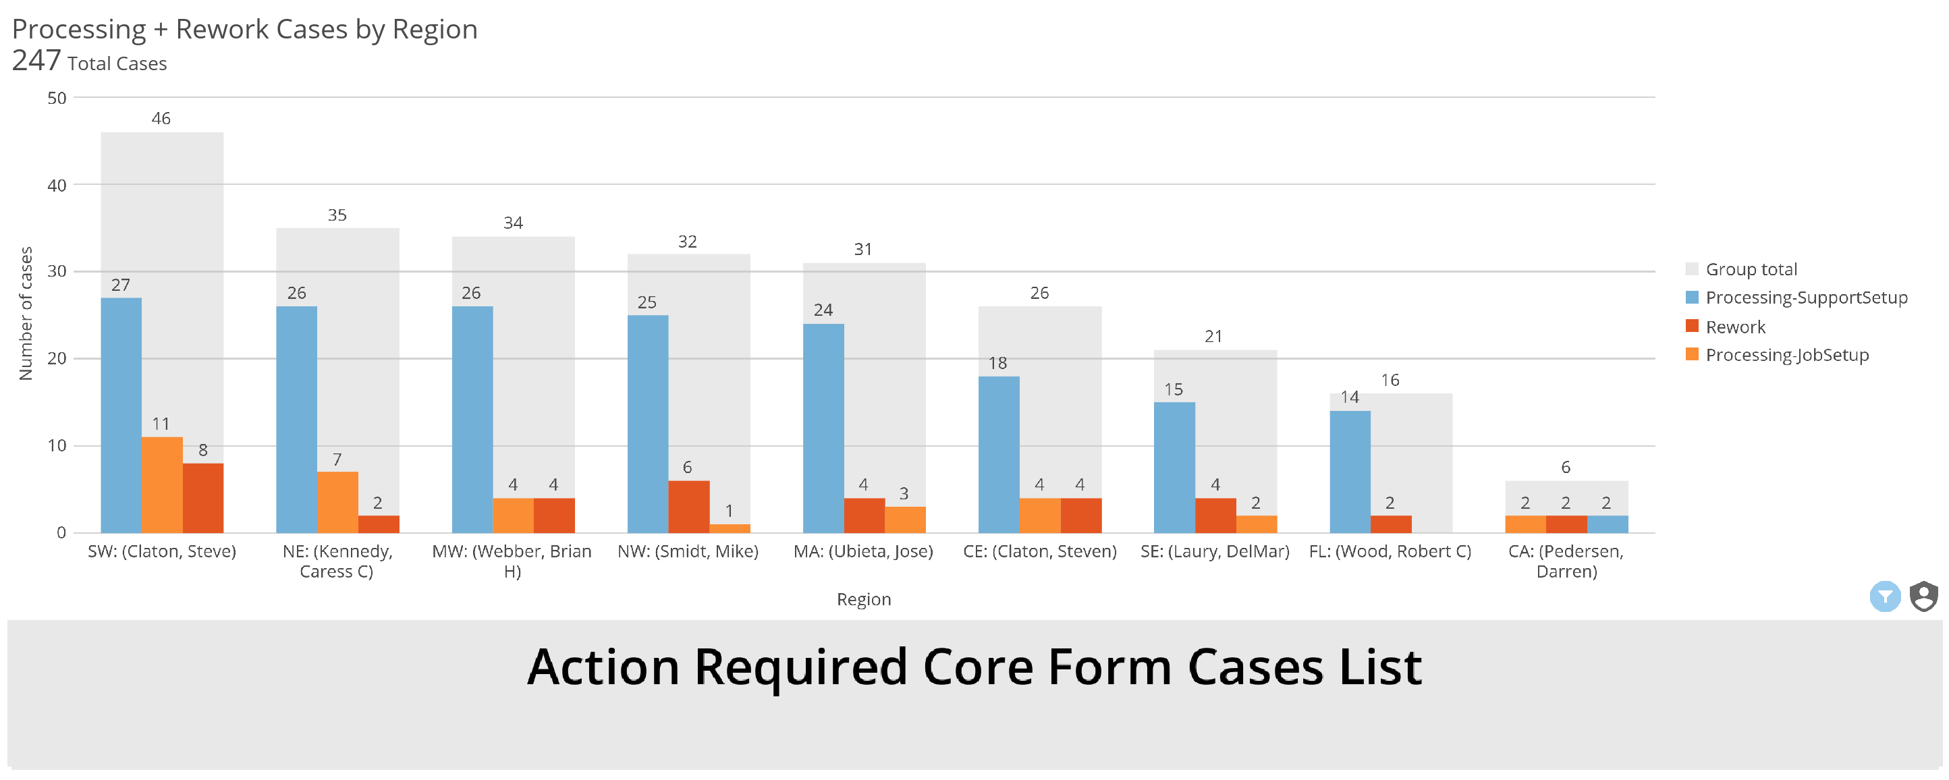

Slide 6
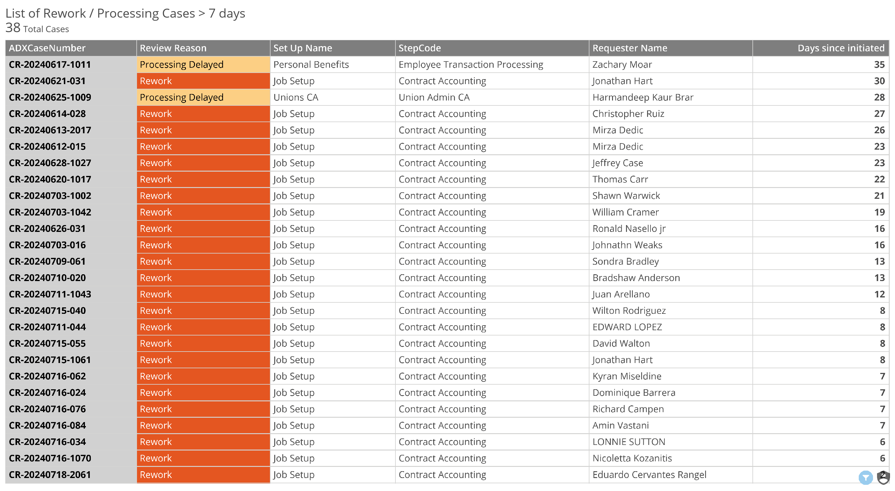

Slide 7
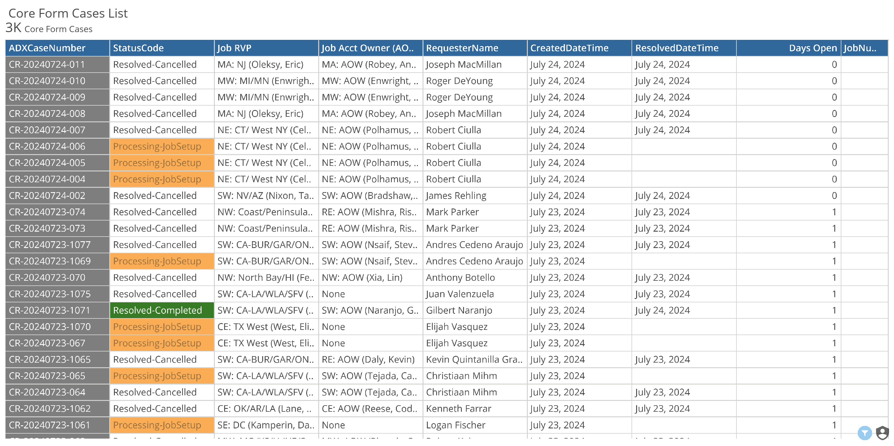

Slide 8
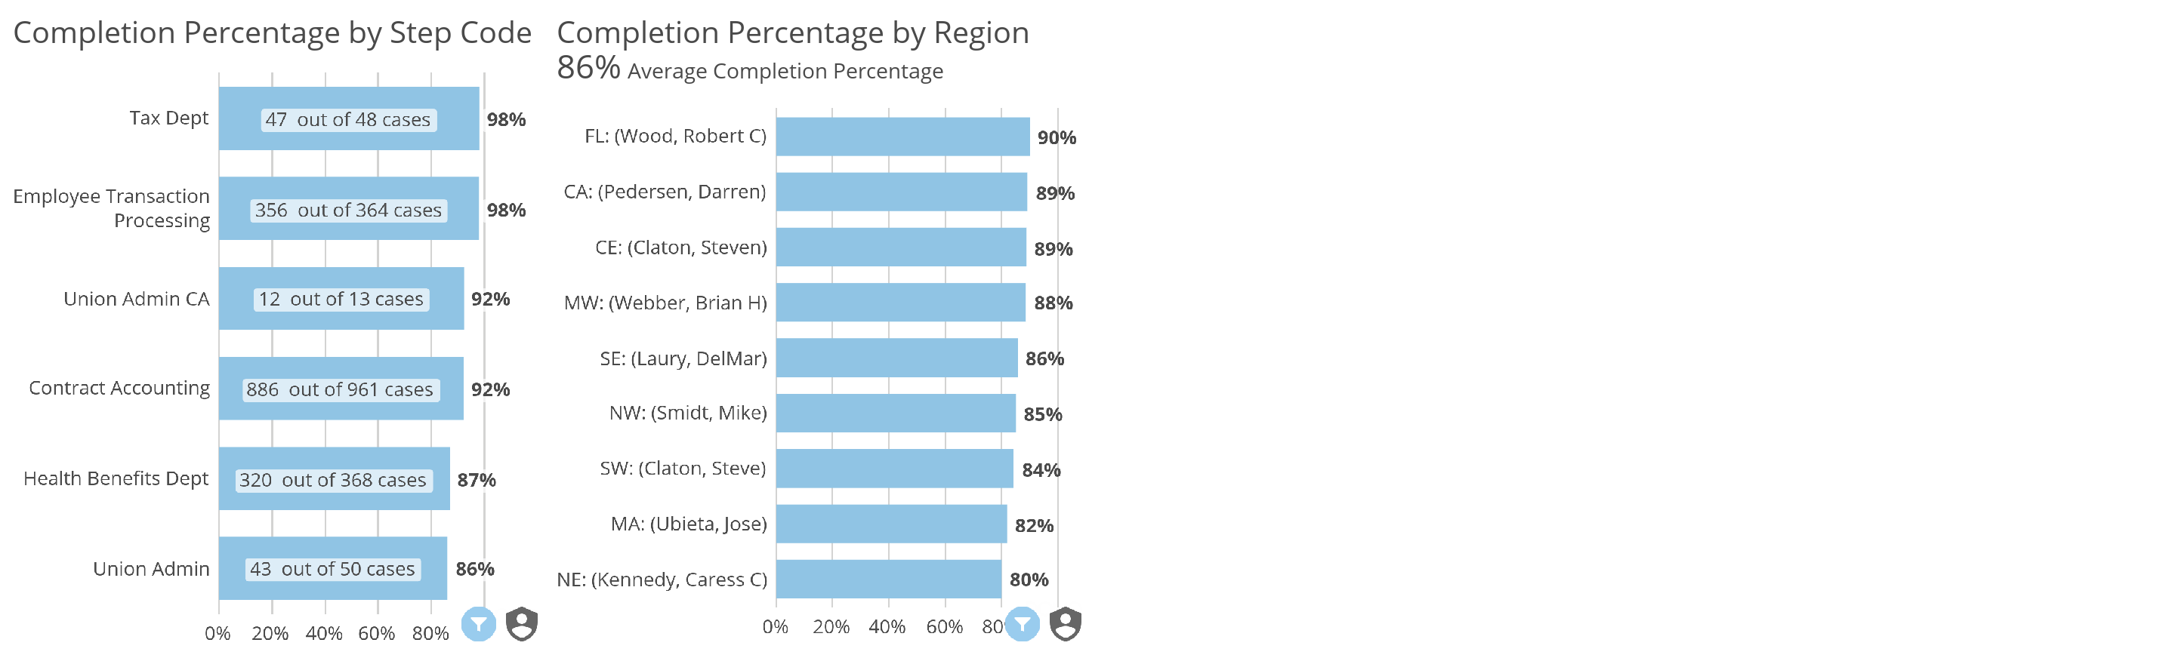
Appendix

